Slide 1
ASSESSMENT OF LABOUR FORCE PARTICIPATION, LITERACY RATE, WORKER POPULATION RATIO AND UNEMPLOYMENT RATE OF ALL THE STATES/U.T OF INDIA: A STATISTICAL STUDY USING R, PYTHON AND EXCEL AND DATA SOURCED FROM MoSPI

Slide 2
Objectives Of Our Project
Analyse the current scenario of labour force participation and working population among men and women in each state/u.t of India.
Examine the literacy and unemployment conditions across rural and urban areas of each state/u.t in India.
Identify the influence of factors like literacy rate, unemployment rate and working rate on labour force participation.

Slide 3
Insight about the Dataset
Type of Data Used – Secondary Data
Data Authorized By – Ministry of Statistics and Program Implementation
Data Collected By – Periodic Labour Force Survey (PLFS)
Variables In the Dataset :
Literacy Rate
Unemployment Rate
Worker Population Ratio
Labour Force Participation Rate
Respondents : Each State and Union Territory of India
Time Frame of the Data Used : June 2022 – July 2023

Slide 4
What Is Mospi?
MoSPI stands for the Ministry of Statistics and Programme Implementation. It is a ministry of the Government of India responsible for overseeing the development and management of statistical data in the country.

Slide 5
What is PlFS?
PLFS stands for Periodic Labour Force Survey. It is a survey conducted by the National Statistical Office (NSO) of India, which operates under the Ministry of Statistics and Programme Implementation (MoSPI). The PLFS is designed to provide comprehensive data on the labor market in India.

Slide 6
How PLFS is done?
The Periodic Labour Force Survey is of two types : Annual Survey & Quarterly Survey.
In this project we have analysed the reports from annual survey of 2022-2023.
Data collection is primarily conducted through face-to-face interviews by trained enumerators, ensuring accurate and reliable information.
The surveys use structured questionnaires to gather consistent and comparable data across different regions and time periods.

Slide 7

Description About the variables used

Slide 8

Literacy Rate
The literacy rate is a statistical measure that indicates the percentage of people within a specified age group who can read and write with comprehension. For India, this specified age group is generally above 7 years.
The literacy rate is typically calculated using the following formula:
Literacy Rate = (Number of Literate Individuals/Total Population in the Age Group) × 100
For example, if a village has 1,000 people aged 7 and above, and 800 of them are literate, the literacy rate would be:
Literacy Rate = (800/1000)×100 = 80%

Slide 9
Unemployment rate
The unemployment rate is a measure of the prevalence of unemployment in an economy. It is typically expressed as a percentage and is calculated by dividing the number of unemployed individuals by the total number of people in the labor force. Here's the formula:
Unemployment Rate = (Number of Unemployed People/Labor Force) × 100
For example, if a village has 1,00,000 people in labor force and 500 of them are unemployed, the unemployment rate would be:
Unemployment Rate = (5000/100000)×100 = 5%

Slide 10

Labour Force Participation Rate
The Labor Force Participation Rate (LFPR) is a measure of the active portion of an economy's labor force. It represents the percentage of the working-age population (typically aged 16 and over) that is either employed or actively seeking employment. The formula for calculating the labor force participation rate is:
LFPR = (Labor Force/Working-Age Population) × 100

Slide 11

Working Population Ratio
The Working Population Ratio, also known as the Employment-to-Population Ratio, measures the proportion of a country's working-age population that is employed. It provides an indication of the ability of an economy to create jobs and the degree to which the working-age population is participating in the labor market. Here, is the formula:
WPR = (No. of Employed/Working-Age Population) × 100

Slide 12

Research Methodology

Slide 13

Graphical Representation
In this project, we have used a mixed variety of graphical measures like:
Simple & Multiple Bar Chart for Comparing Literacy Rates, Unemployment Rates, Labour Force Participation Rate, etc.
Pie Chart for summarizing the structure of target population, for example – composition of people surveyed, composition of men & women, composition of people in rural & urban areas of India.
Scatter Plot for examining the relation between two variables, for example, relationship between labour force participation rate & working rate.

Slide 14

Statistical tests
Two-Sample Proportion Test:
A two-sample proportion test is a statistical method used to compare the proportions of a particular characteristic in two independent groups to determine if there is a significant difference between them.
A two-proportion z-test always uses the following null hypothesis:
H₀: μ₁ = μ₂ (the two population proportions are equal)
The alternative hypothesis can be either two-tailed, left-tailed, or right-tailed:
H₁ (two-tailed): π₁ ≠ π₂ (the two population proportions are not equal)
H₁ (left-tailed): π₁ < π₂ (population 1 proportion is less than population 2 proportion)
H₁ (right-tailed): π₁ > π₂ (population 1 proportion is greater than population 2 proportion)

Slide 15
We use the following formula to calculate the test statistic z:
z = (p₁ - p₂) / √p(1-p)(1/n₁+1/n₂)
where p₁ and p₂ are the sample proportions, n₁ and n₂ are the sample sizes, and where p is the total pooled proportion calculated as:
p = (p₁n₁ + p₂n₂)/(n₁+n₂)
If the p-value that corresponds to the test statistic z is less than your chosen significance level (common choices are 0.10, 0.05, and 0.01) then you can reject the null hypothesis.

Slide 16
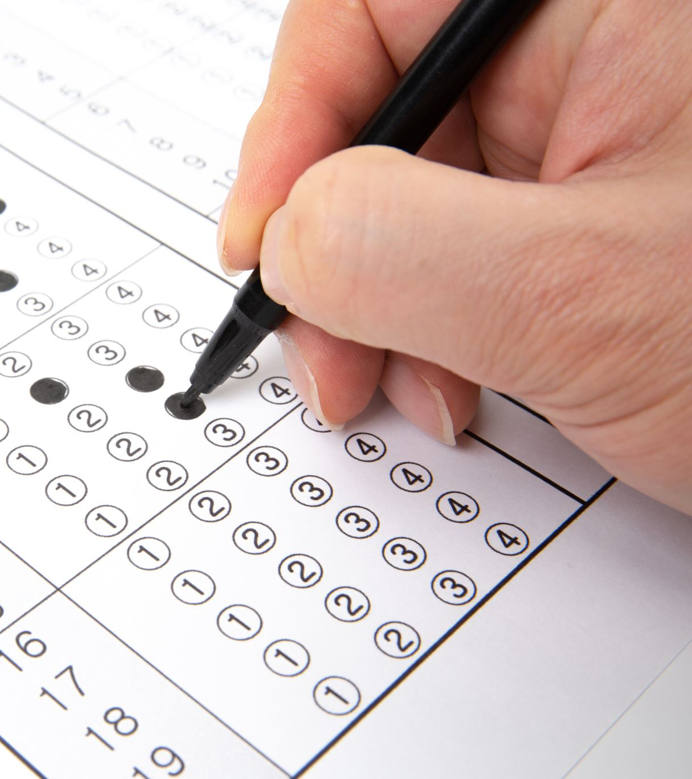
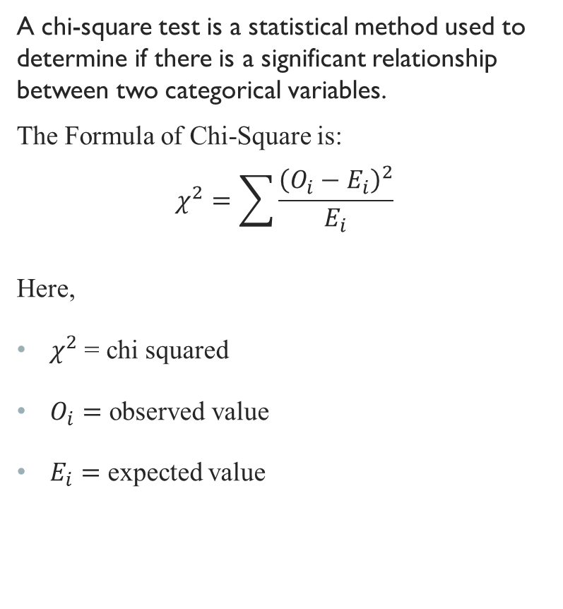
Chi-Square Test Of Independence
A chi-square test is a statistical method used to determine if there is a significant relationship between two categorical variables.
The Formula of Chi-Square is:
$$χ^{2}=\sum{\frac{{\left(O_{i}−E_{i}\right)}^{2}}{E_{i}}}$$
Here,
$χ^{2}$= chi squared
$O_{i}=$ observed value
$E_{i}=$ expected value

Slide 17

Shapiro Wilk’s Test
The Shapiro-Wilk test is a statistical test used to determine whether a sample comes from a normally distributed population. It tests the null hypothesis that the sample is drawn from a normal distribution.
The formula for the W value is
$W=\frac{{(\sum_{i=1}^{n}{a_{i}x_{i})}}^{2}}{\sum_{i=1}^{n}{{(x_{i}−\overline{ x})}^{2}}}$
where, xi are the ordered random sample values and ai are constants generated from the covariance, variances and means of the sample (size n) from a normally distributed sample. The test has limitations, most importantly that the test has a bias by sample size. The larger the sample, the more likely you’ll get a statistically significant result.

Slide 18

Linear Model
Simple Linear Regression:
In statistics, simple linear regression is a linear regression model with a single explanatory variable That is, it concerns two-dimensional sample points with one independent variable and one dependent variable (conventionally, the x and y coordinates in a Cartesian coordinate system) and finds a linear function (a non-vertical straight line) that, as accurately as possible, predicts the dependent variable values as a function of the independent variable. The adjective simple refers to the fact that the outcome variable is related to a single predictor.
The formula for a Simple linear regression is:
$Y=β_{0}+β_{1}X+ε$
Y is the response variable, X is the explanatory variables,$β_{0}$ is the y-intercept (constant term), $β_{1}$ is the slope coefficients for each explanatory variable, ε is the random error term (also known as the residuals).

Slide 19

Software Used
Data Organization : Microsoft Excel
Data Cleaning : Python and Excel
Data Visualization: Python (Matplotlib) & R
Data Analysis : R

Slide 20
Data Analysis

Slide 21
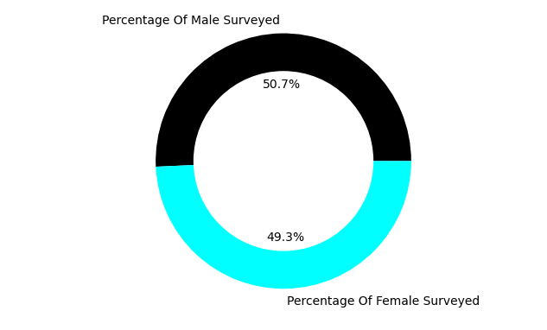
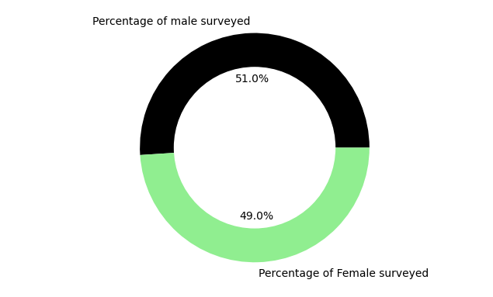
Summary Of the People Surveyed
People Surveyed In Rural areas
People Surveyed In urban areas

Slide 22
Association Tests

Slide 23
Assessment of Literacy
Gender-Wise Associativity
Area-Wise Associativity
 | Literate | Illiterate
Male | 186725 | 26259
Female | 157272 | 52556
 | Literates | Illiterates
Urban | 157273 | 18268
Rural | 193170 | 50801
## Pearson's Chi-squared test with Yates' continuity correction ## ## data: data ## X-squared = 11272, df = 1, p-value < 2.2e-16
## Pearson's Chi-squared test with Yates' continuity correction ## ## data: data ## X-squared = 8052.1, df = 1, p-value < 2.2e-16

Slide 24
Assessment of Labour Force Participation
Gender-Wise Associativity
Area-Wise Associativity
 | Participation | No Participation
Male | 118020 | 95264
Female | 44860 | 162168
 | Participation | No Participation
Urban | 67583 | 107958
Rural | 95393 | 148578
## Pearson's Chi-squared test with Yates' continuity correction ## ## data: data ## X-squared = 51031, df = 1, p-value < 2.2e-16
## Pearson's Chi-squared test with Yates' continuity correction ## ## data: data ## X-squared = 15.46, df = 1, p-value = 8.426e-05

Slide 25
Assessment of Unemployment
Gender-Wise Associativity
Area-Wise Associativity
 | Unemployed | Not Unemployed
Male | 9653 | 203631
Female | 13475 | 192753
 | Unemployed | Not Unemployed
Urban | 11652 | 163889
Rural | 9278 | 234693
## Pearson's Chi-squared test with Yates' continuity correction ## ## data: data ## X-squared = 811.29, df = 1, p-value < 2.2e-16
## Pearson's Chi-squared test with Yates' continuity correction ## ## data: data ## X-squared = 1730.2, df = 1, p-value < 2.2e-16

Slide 26
Assessment of Working Population
Gender-Wise Associativity
Area-Wise Associativity
 | Working | Not Working
Male | 115222 | 98063
Female | 44114 | 162114
 | Working | Not Working
Urban | 63546 | 111995
Rural | 96197 | 147774
## Pearson's Chi-squared test with Yates' continuity correction ## ## data: data ## X-squared = 47395, df = 1, p-value < 2.2e-16
## Pearson's Chi-squared test with Yates' continuity correction ## ## data: data ## X-squared = 451.46, df = 1, p-value < 2.2e-16

Slide 27
Proportion tests

Slide 28


Literacy Among states/u.t’s
Area-wise proportion test for all India
In this section we are going to perform a two-sample proportion test on the rural and urban regions of India. To continue with the test let us look at some of the notations used:
$H_{0}$ - Null Hypothesis
$H_{1}$ - Alternative Hypothesis
$P_{L},_{R}$ - Proportion of literate people in rural area
$P_{L},_{U}$ - Proportion of literate people in urban area
Null & Alternative Hypothesis
$H_{0}$ : $P_{L},_{R}$ = $P_{L},_{U}$
$H_{1}$ : $P_{L},_{R}$ < $P_{L},_{U}$
## No. of Literate People Surveyed ## Rural 193170 243971 ## Urban 157273 175541
## X-squared = 8052.1, df = 1, p-value < 2.2e-16

Slide 29
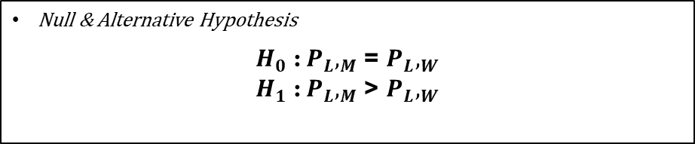
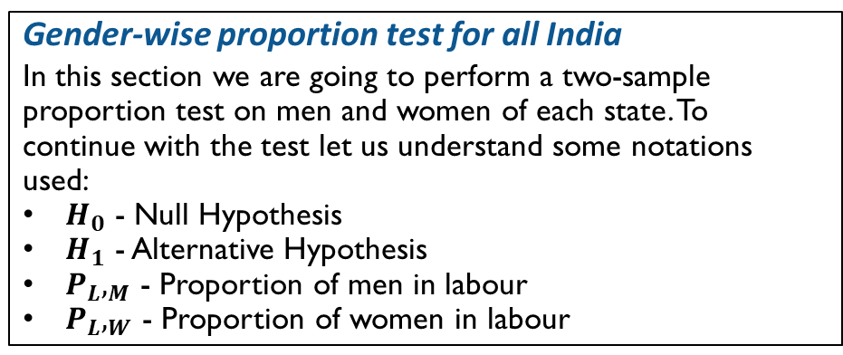
Labour Force Participation Among states/u.t’s
Gender-wise proportion test for all India
In this section we are going to perform a two-sample proportion test on men and women of each state. To continue with the test let us understand some notations used:
$H_{0}$ - Null Hypothesis
$H_{1}$ - Alternative Hypothesis
$P_{L},_{M}$ - Proportion of men in labour
$P_{L},_{W}$ - Proportion of women in labour
Null & Alternative Hypothesis
$H_{0}$ : $P_{L},_{M}$ = $P_{L},_{W}$
$H_{1}$ : $P_{L},_{M}$ > $P_{L},_{W}$
## No. of people in labour People Surveyed ## Men 119545 213285 ## Women 49403 206228
## X-squared = 44896, df = 1, p-value < 2.2e-16

Slide 30
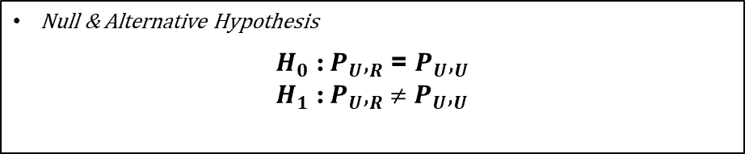

Unemployment Among states/u.t’s
Area-wise proportion test for all India
In this section we are going to perform a two-sample proportion test on the rural and urban regions of each state. To continue with the test let us look at some of the notations used:
$H_{0}$ - Null Hypothesis
$H_{1}$ - Alternative Hypothesis
$P_{U},_{R}$ - Proportion of unemployed people in rural area
$P_{U},_{U}$ - Proportion of unemployed people in urban area
Null & Alternative Hypothesis
$H_{0}$ : $P_{U},_{R}$ = $P_{U},_{U}$
$H_{1}$ : $P_{U},_{R}$ ≠ $P_{U},_{U}$
## No. of unemployed People Surveyed ## Rural 9278 243971 ## Urban 11652 175541
##X-squared = 1730.2, df = 1, p-value < 2.2e-16

Slide 31
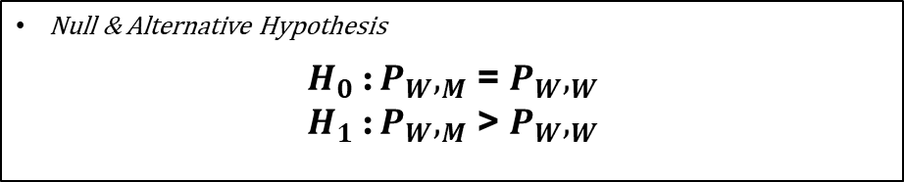
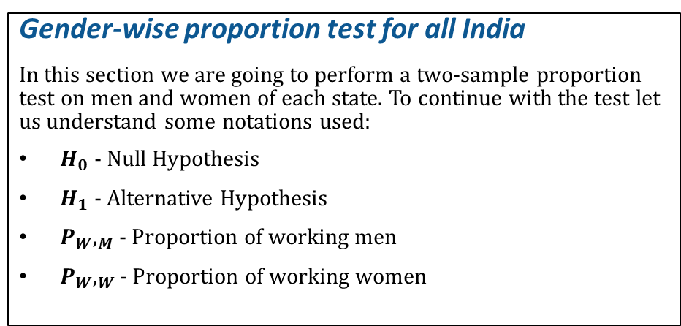
Working Population Among states/u.t’s
Gender-wise proportion test for all India
In this section we are going to perform a two-sample proportion test on men and women of each state. To continue with the test let us understand some notations used:
$H_{0}$ - Null Hypothesis
$H_{1}$ - Alternative Hypothesis
$P_{W},_{M}$ - Proportion of working men
$P_{W},_{W}$ - Proportion of working women
Null & Alternative Hypothesis
$H_{0}$ : $P_{W},_{M}$ = $P_{W},_{W}$
$H_{1}$ : $P_{W},_{M}$ > $P_{W},_{W}$
## No. of Working People People Surveyed ## Men 113041 213285 ## Women 42895 206228
##X-squared = 46548, df = 1, p-value < 2.2e-16

Slide 32
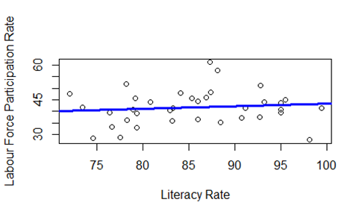
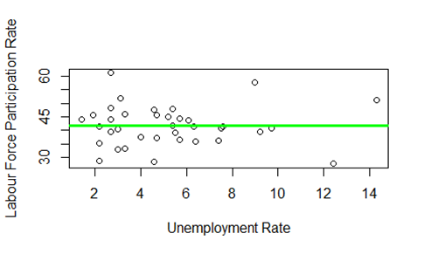
Regression Analysis
Labour Force Participation Rate vs Literacy Rate
Labour Force Participation rate vs Unemployment rate
Labour Force Participation Rate = 31.7498 + 0.1163 Literacy Rate + Error
Labour Force Participation Rate = 41.67 + 0.00074 Unemployment Rate + Error

Slide 33
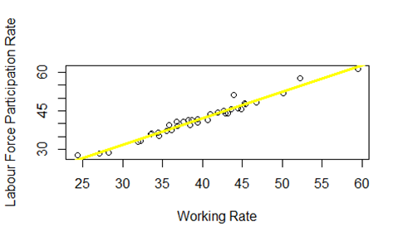
Labour Force Participation Rate vs Working Rate
Labour Force Participation Rate = 1.2413 + 1.0239 Working Rate + Error

Slide 34
Thank You

